Slide 1
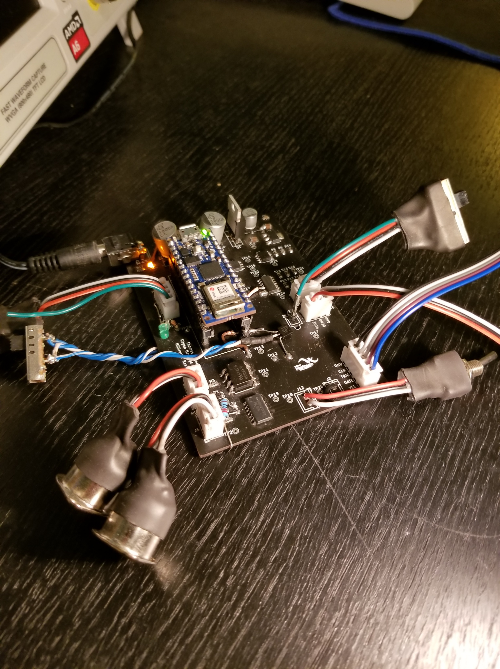
MIDI-Verter!
The Universal Translator
… For Synthesizers!
Thomas Skene
The MIDI-Verter is the musician’s Swiss army knife. It hooks up to any analog synthesizer and turns it into a MIDI-ready instrument!
-Play it with your keyboard!
-Play it with your synth guitar!
-Play it with your drum pad controller!
-Play it with your phone!

